Slide 1

DIGICROME ACADEMY
NEXT HIKES
2023-24

Slide 2
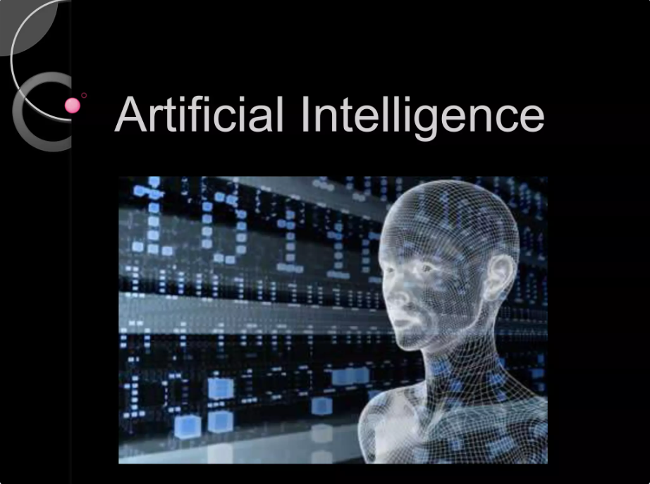
What do you think Artificial Intelligence is?
LLM Project: Building a News Research Tool

Slide 3
PROBLEM STATEMENT
Phase 1: Environment Setup
Phase 2: LangChain Configuration
Phase 3: Building Streamlit Interface
Phase 4: Enhancing the Tool
Phase 5: Testing and Validation
Phase 6: Documentation and Finalization

Slide 4
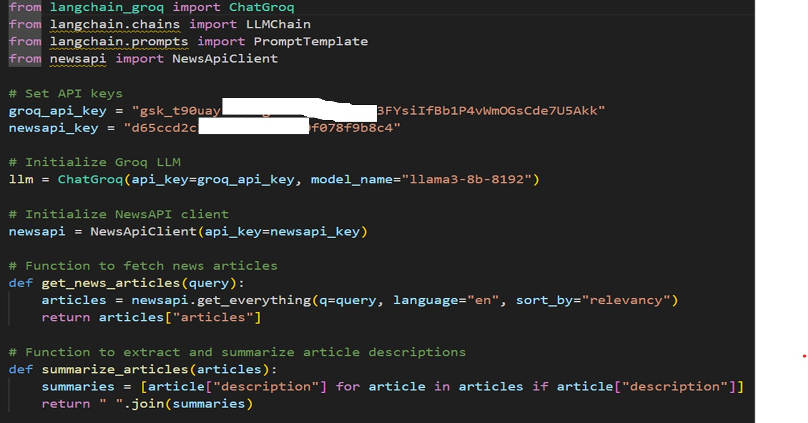

Slide 5
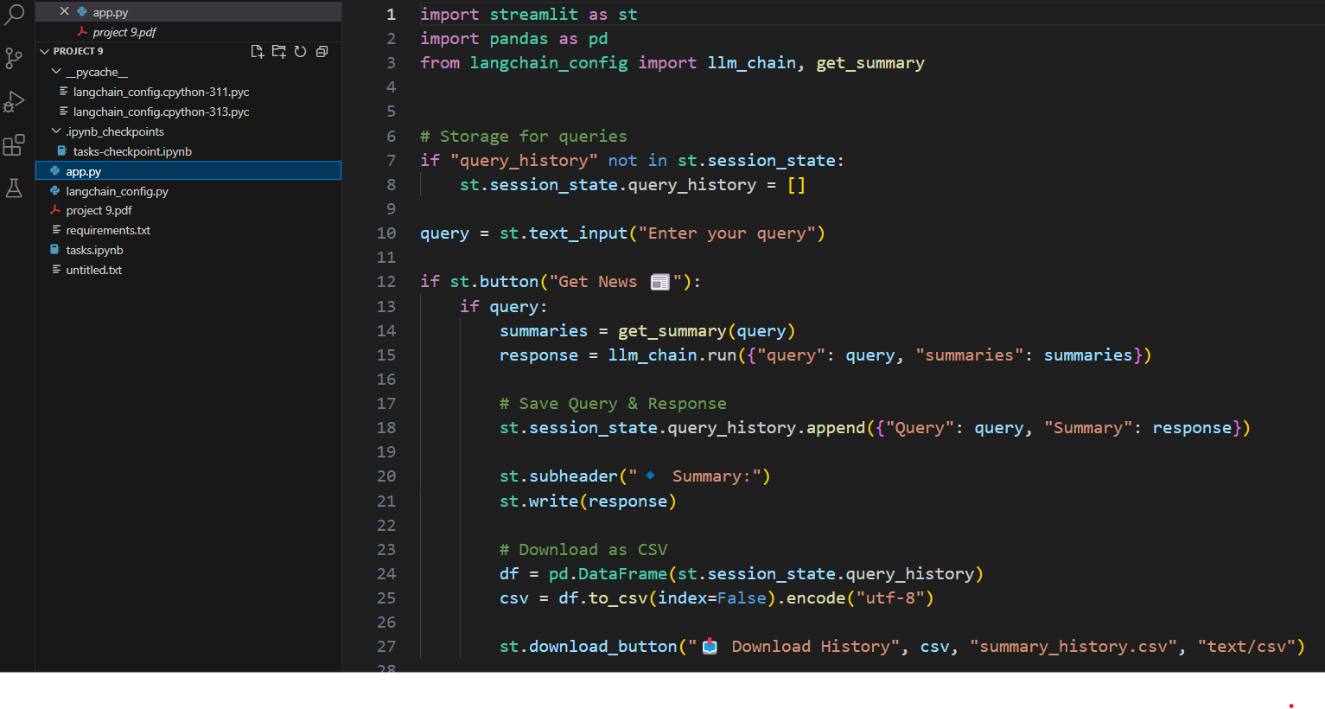

Slide 6
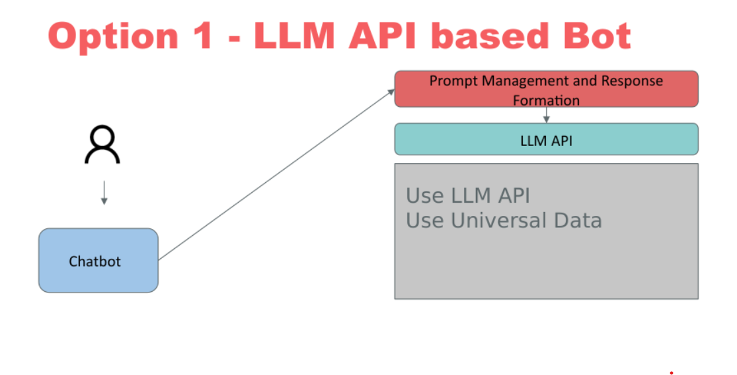
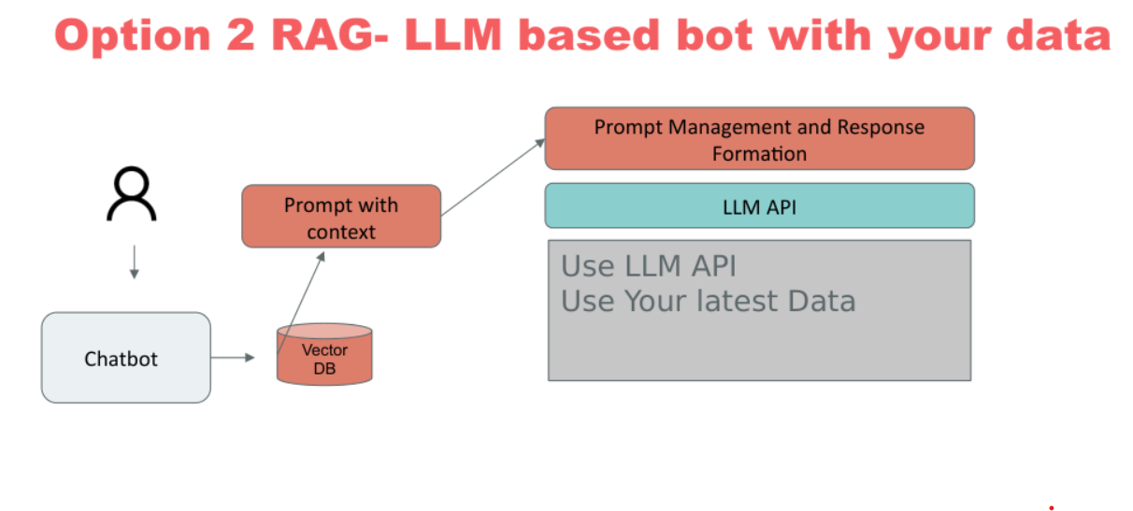

Slide 7
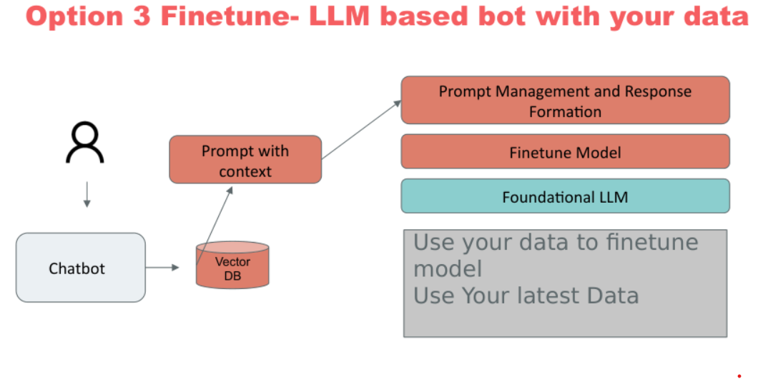
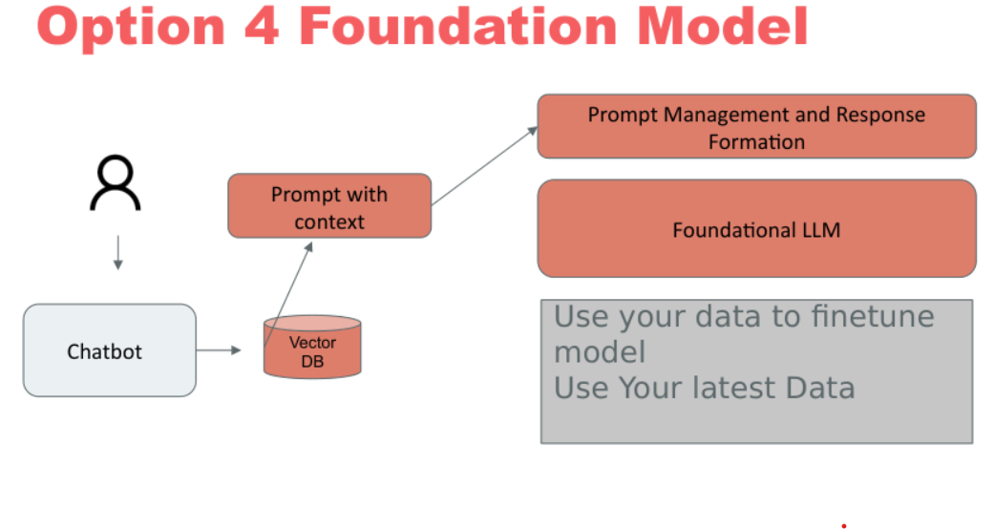

Slide 8


